Slide 1
Tactile Map Creation Service for the Blind ―13 Years’ Practice and the Recent Trend―
Tetsuya Watanabe (University of Niigata)
Kazunori Minatani (Nat. Center for Univ. Entrance Exams)

Slide 2
Issues on making tactile maps
Need much time, efforts, and skills
⇒ Hard to respond to individual needs
Development of tactile map automated creation system (tmacs) enables us to create tactile maps of any location instantly

Slide 3
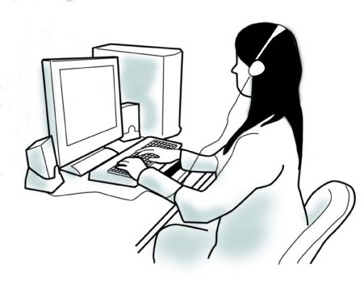
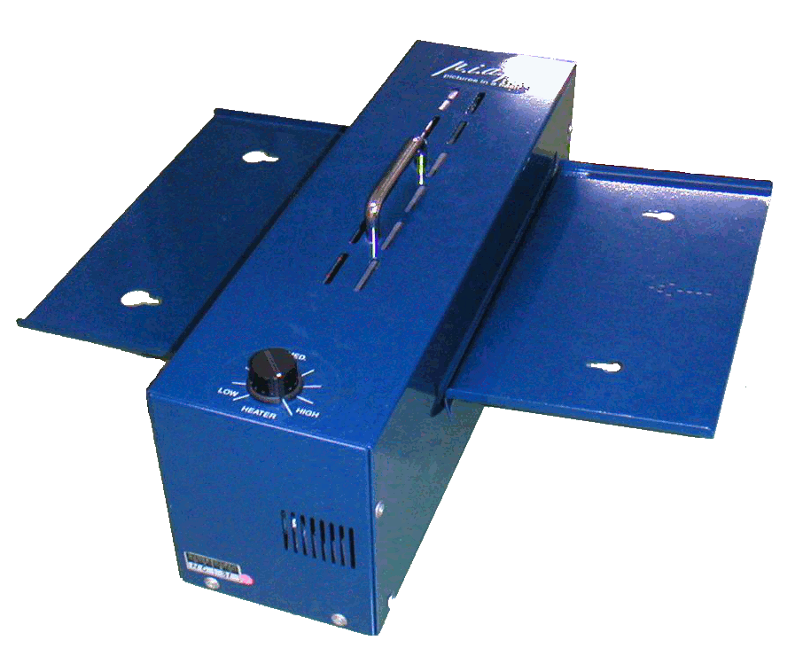
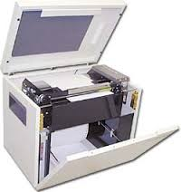
tmacs is a Web app so that everyone can use, but...
Few people own capsule paper heater nor embosser

Slide 4
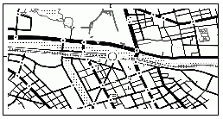
Tactile map creation service

Slide 5
History relating tactile map creating service
2004 Impressed with TMAP at RESNA
2008 Development of tmacs
June 2010 Launched tactile map creating service using tmacs
2018 tmcas using OSM data
2020 tactile map drawing system

Slide 6
Tactile map creation service
Announcement
Symposium
Lab Web site
Magazines blind community are subscribing
Sight World
Requests coming in by email
Blind people themselves or librarians find our site
Necessary info: location, range, landmarks to place, purpose, shipping address
For free (to know necessity blind people)

Slide 7
Sight World Exhibition
Biggest exhibition for blind and low vision people in Japan
3550 visitors in 2023
Every year, Nov. 1-3, commemorating establishment of Japanese Braille
AI, ICT devices and goods, braille print, magnifier, home appliances, daily commodities
Watanabe lab is exhibiting 13 consecutive times (including as NISE, Watanabe's former affiliation)

Slide 8
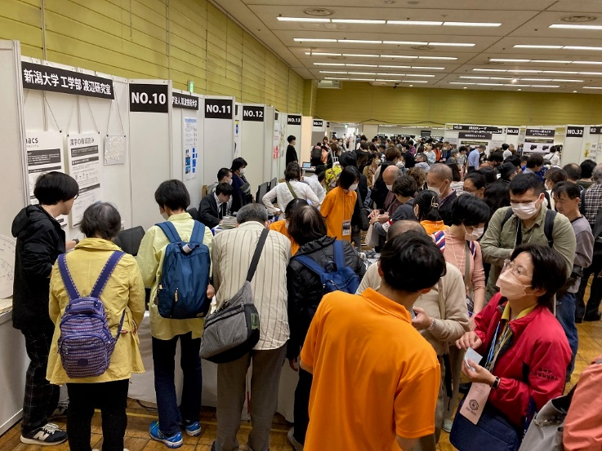
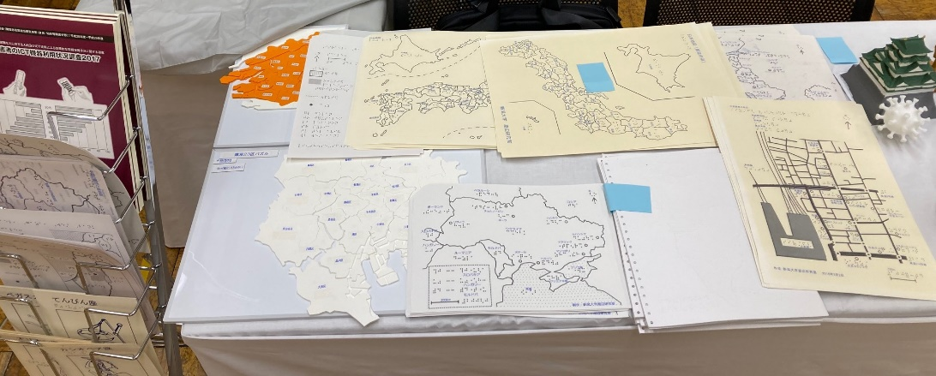
Sight World: biggest promoting event for tactile maps
Making tactile maps on demand, on site
Disseminating popular maps: map of Japan, floor plans of big and busy stations, road and shop maps around these stations, world maps (and tactile constellation cards)
More than 700 sheets were handed out in 2023

Slide 9
Classification of tactile maps ever created
Individual tactile map creation service
281 maps created from June 2010 to June 2023 except at Sight World
Road map
Regional map
Park map
Floor plan
Intersection model
Train/bus route map
World map
Terrain model
3D cityscape
0
20
40
60
80
100
120

Slide 10
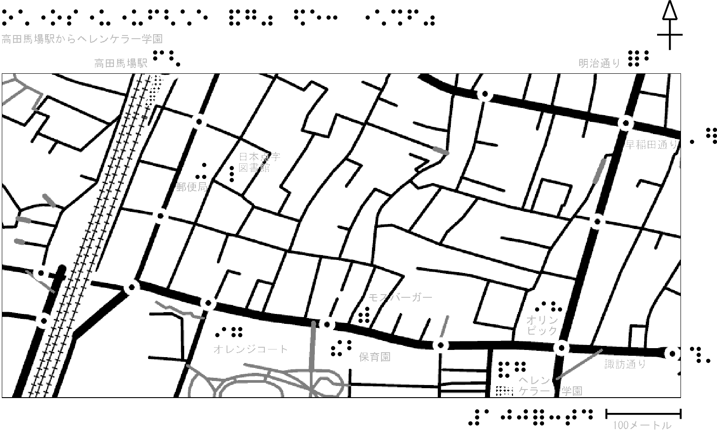
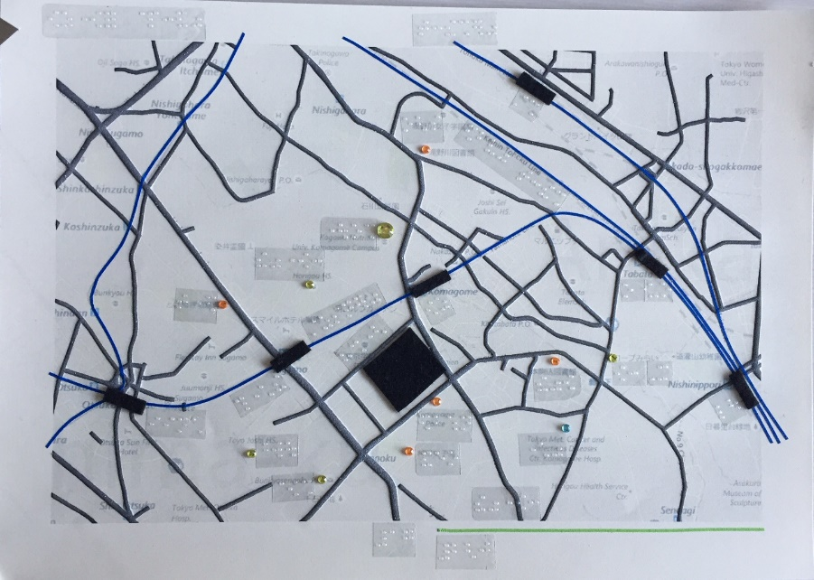
Road maps for independent travel
"I became to walk alone to the station after several practices."

Slide 11
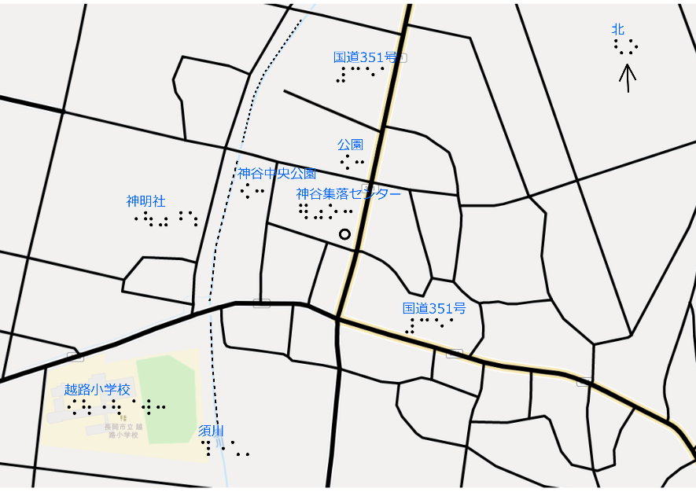
Area maps for familiarization
Want to know the town just after moving
It becomes easy to image the town when explained with one or two main street(s)

Slide 12
Park maps
Yoyogi Park Map for blind runners
Huis Ten Bosch
Issues on how to express open spaces
⇒ 3D terrain model is more useful?

Slide 13
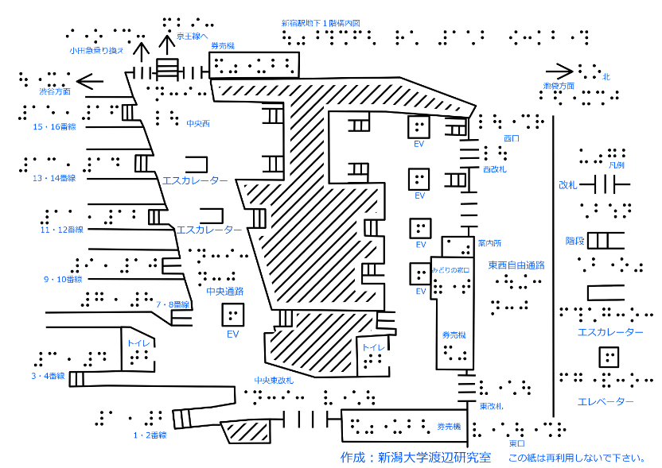
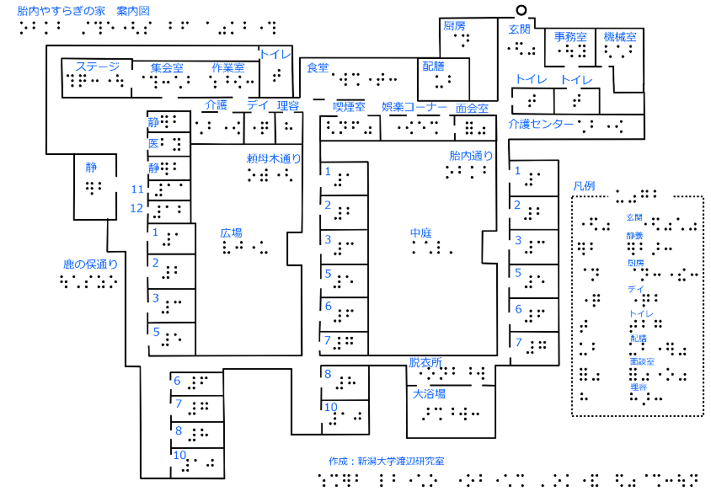
Floor plans
With tactile floor plan, I could walk around the venue on my own.
I wanted this when I started using this facility.

Slide 14
Intersection models
Niigata station
Toyota city
In maps, a road is implicitly expressed with a line.
Howerver, in large scale maps
Roads have width
Separate sidewalks from driveways
Steps between these and buildings ⇒ realistic and intuitive
Steps made by pasting cardboard and styrene board

Slide 15
Train/bus route map
Chiba prefecture
Osaka Metro subway
Many rail fans or lovers
even among bind people

Slide 16
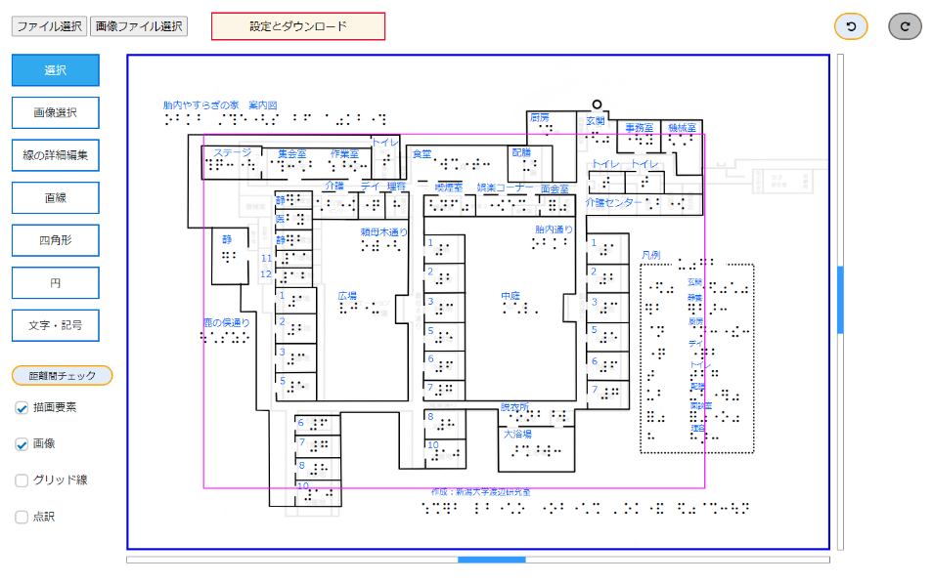
How to make tactile maps
tmacs [mb]
Mori's drawing app
Gain road map image for capsule paper instantly only by selecting address
Specialized for drawing tactile maps

Slide 17
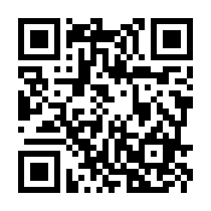
tamcs [mb]
https://hourclock.github.io/tmacs-MB/tmacs_en.html

Slide 18
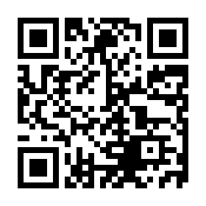
Mori's tactile map drawing app
https://stevenyuta.github.io/tactilemapyuta/

Slide 19
Recent Trend
Maps in the news
Terrain models and hazard maps

Slide 20
World Maps: News thru Touch
Ukraine
Turkey and Syria
Everyday I have been frustrated to hear the news of Ukraine for not knowing its geography.
With this map, I finally understood the locations of the cities of Ukraine and its surrounding countries, with their sizes, which I had not known only by listening to the news.

Slide 21
Terrain models
Mt. Shinobu
(Fukushima, Japan)
Mt. Takao (Tokyo, Japan)
Blind School's trip sites

Slide 22
Terrain models: Seacoasts
Shima Peninsula
Sanriku coastline
1 mm step at coastline to be traceable with fingers
Different colors to different heights for low vision users

Slide 23
Needs for hazard maps for the blind
Miyazaki, Japan
Kagoshima, Japan

Slide 24
Future tasks
Tactile map creating workshop
Both for tactile map users and potential tactile map creators
Tactile map creating manual

Slide 25
Discussion
Online Tactile Map Creation App
Tactile Map Service
How to use our apps

Slide 26
Online Tactile Map Creation App
TMAP
tmacs
Touch Mapper
Route Tactile
Do you know
How often they have been used? Any documents?
Other Apps?

Slide 27
Tactile Map Service
SF Lighthouse's MAD Lab
Watanabe Lab, Univ. of Niigata
Do you know any other service?

